Slide 1
Networks of Innovators. In the Oxford Handbook of Innovation
Powell, Walter, and Stine Grodal. 2012. edited by Jan Fagerberg, David C. Mowery, and Richard R. Nelson. Oxford University Press
[STP510] SeungChan Choi

Slide 2
Contents
Introduction
Why Have Networks Grown In Importance?
Varieties of Networks
Empirical Studies of the Role of Networks in Innovation
Knowledge Transfer
Governance and Incentive Issues
Summary

Slide 3
Preview of Conclusion
1) Networks contribute to the innovative capabilities
Empirical Studies
2) Sharing information
Tacit knowledge vs Explicit knowledge
3) Varieties of Network
Strong tie, Weak tie, Redundant tie, Structural Hole

Slide 4
Introduction
Model of Networks of innovators has become commonplace over the past two decades
The diversity of research actors make innovation process more considerably.
Much of research focuses on the effects of networks on patenting, access to information, and the generation of novel ideas.

Slide 5
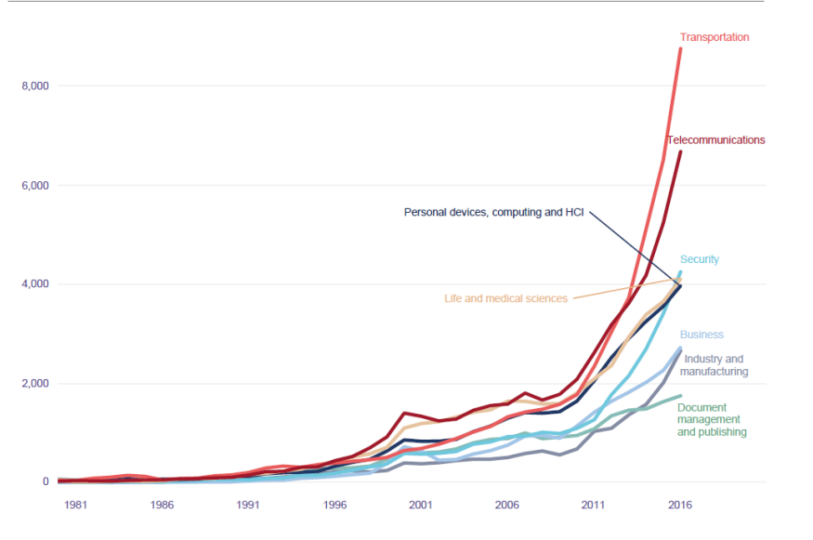
Why Have Networks Grown In Importance?
Information diffusion, resource sharing, access to specialized assets, and interorganizational learning
Able to fill in what’s lacking
Follow the rapid growth in S&T
글로벌 인공지능(AI) 특허 동향과 시사점 2019년 DNA 플러스, AI 활용분야별 출원추이

Slide 6
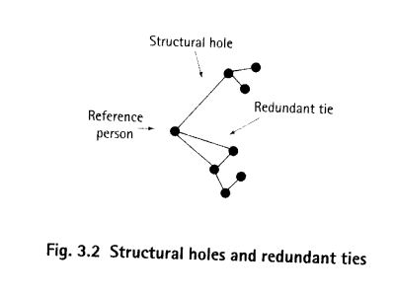
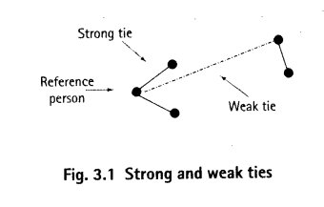
Varieties of Networks
The form of network also varies
Include based on formal contractual relations
B
A
C
D

Slide 7

Empirical Studies of the Role of Networks in Innovation
There are a number of positive cases about innovation through networks
Linux, the computer networking

Slide 8
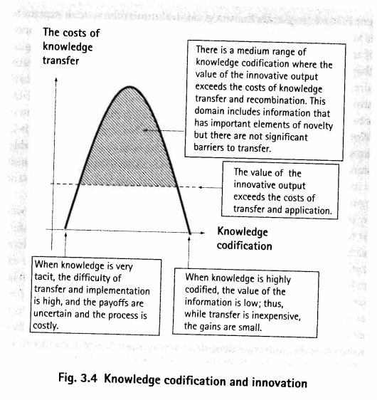
Knowledge Transfer
Division of innovative labor.
Recombine the information within a network in novel ways.
Tacit, Explicit Knowledge

Slide 9
Governance and Incentive Issues
There are lack for the long term research (specific time point)
Termination of Network doesn’t mean failure
Terminating cost
Stagnation of information exchange cause decline the growth

Slide 10
Summary
1) Networks contribute to the innovative capabilities
Empirical Studies
2) Sharing information
Tacit knowledge vs Explicit knowledge
3) Varieties of Network
Strong tie, Weak tie, Redundant tie, Structural Hole

Slide 11
Thank you
Q&A

